Slide 1


Lecture 25 - Part 2 Presentation Layer Design -- Dynamic Graphics Generation -- Animation -- Mobile Applications
CSE 445 / 598
Distributed Software Development
7
Presentation
Layer (GUI)
5
5
Application
Processing Layer
Textbook Chapter 5, Section 5.6
Service Repository
Layer
Dr. Yinong Chen
https://myasucourses.asu.edu/
Data Management
Layer

Slide 2
“One picture is worth a thousand words”
Static graphics is important in Web design;
It is available in Web 1.0;
Dynamic graphics
Use it to make the human users love your site
Use it to prevent programmed attacks to your site
Use it only if it is necessary:
Text cannot do the job;
Static graphics cannot do the job;
Make it efficient
Use efficient algorithms (Take a Graphics course)
Use AJAX to reload the part that changes
Use Caching to reuse the generated images
Use Out-Of-Browser computing, e.g., Flash and Silverlight

Slide 3
Types of Dynamic Graphics Supported
ASP .Net
Bitmap and Drawing
Shapes and Geometries
Brushes and Painting
Windows Presentation Foundation and Silverlight
Bitmap and Drawing
Shapes and Geometries
Brushes and Painting
Animation, programmed in C# and in XAML used in the model of Out-Of-Browser Computing
To be discussed in today’s lecture
To be discussed in today’s lecture
To be discussed in the next lecture

Slide 4
Graphics Device Interface GDI and GDI+
Windows Graphics Device Interface: GDI
Available to the languages running on Windows, C, C++, and Java
VS Graphics Device Interface: GDI+, offers classes of
creating and rendering graphics,
drawing text, and
manipulating graphical images
GDI+ can render graphical images on
Windows Forms (ASPX)
User controls (ASCX)

Slide 5
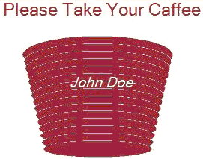
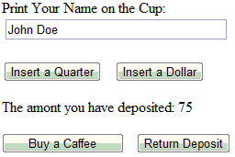
The Model of GDI+ Dynamic Graphics
Input:
Dimensions
Shape
Text
Html page
Graphics Generation
Html stream
Graphics Rendering
User Control
Html stream

Slide 6
GDI+ Classes in ASP .Net
http://msdn.microsoft.com/en-us/library/aa925824.aspx
http://msdn.microsoft.com/en-us/library/aa983677(v=VS.71).aspx
Bitmap: Creating a bitmap pattern
Graphics: Creating an image on a Bitmap object of different formats: Gif, Jpeg, Png, etc.;
Pens: Draw lines, curves, and outline-shapes
Brushes: Create solid shapes and render text into images;
Colors: Used with Pens and Brushes to specify the colors to be rendered.

Slide 7
Case Study: A Vending Machine with Dynamic Graphics
Textbook Chapter 5, Section 5.6
If (Sum>75)
Sum = Sum – 75
release coffee
If Sum < 75, do nothing
quarter
dollar
coffee
0
> 0
quarter
dollar
If (Sum== 75)
release coffee
Sum = Sum + 25
Sum = Sum + 100
return

Slide 8
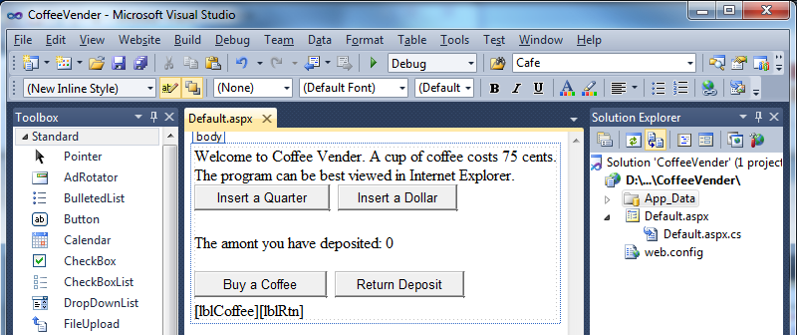
Coffee Vending Machine GUI Design
Take A Simple Approach to Getting Started with GDI+
Label to display the coffee cup
Label to display the returned coins

Slide 9
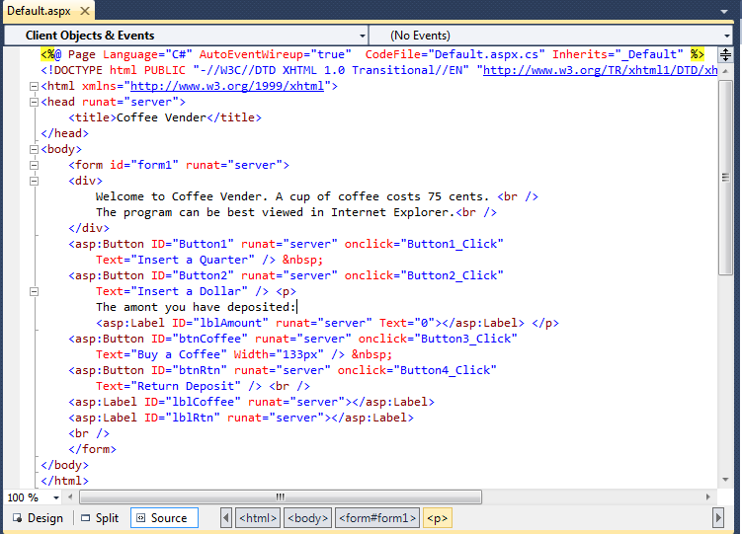
Default.aspx Source
Label to display the coffee cup
Label to display the returned coins

Slide 10
Code Behind the Default.aspx Page (1)
using System;
using System.Drawing;
public partial class _Default : System.Web.UI.Page {
protected void Page_Load(object sender, EventArgs e) { // initialization
if (Session["Sum"] == null)
Session["Sum"] = 0;
lblAmount.Text = "0";
}
protected void Button1_Click(object sender, EventArgs e) { // insert quarter
Int32 Sum = (Int32)Session["Sum"];
Sum = Sum + 25;
Session["Sum"] = Sum;
lblAmount.Text = Convert.ToString(Sum);
lblRtn.Text = "[ ]";
}
// Continued on next page
quarter
If (Sum>75)
Sum = Sum – 75
release coffee
If Sum < 75, do nothing
coffee
dollar
0
> 0
dollar
quarter
If (Sum== 75)
release coffee
Sum = Sum + 25
Sum = Sum + 100
return

Slide 11
Code Behind the Default.aspx Page (2)
// from last page
protected void Button2_Click(object sender, EventArgs e)
{ // insert dollar
Int32 Sum = (Int32)Session["Sum"];
Sum = Sum + 100;
Session["Sum"] = Sum;
lblAmount.Text = Convert.ToString(Sum);
lblRtn.Text = "[ ]";
}
protected void Button3_Click(object sender, EventArgs e) { // buy a Coffee
Int32 Sum = (Int32)Session["Sum"];
if (Sum >= 75) {
Sum = Sum - 75;
Session["Sum"] = Sum;
lblAmount.Text = Convert.ToString(Sum);
lblCoffee.Text = "Please take your Coffee here";
lblRtn.Text = "[ ]";
quarter
If (Sum>75)
Sum = Sum – 75
release coffee
If Sum < 75, do nothing
dollar
coffee
0
> 0
dollar
quarter
If (Sum== 75)
release coffee
Sum = Sum + 25
Sum = Sum + 100
return

Slide 12
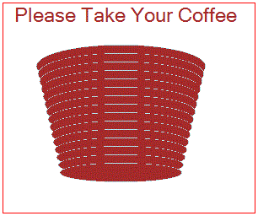
Code Behind the Default.aspx Page (3)
Bitmap imageCoffee = new Bitmap(300, 250);
Graphics gCoffee = Graphics.FromImage(imageCoffee);
gCoffee.FillRectangle(Brushes.White, 0, 0, 300, 250);
gCoffee.DrawRectangle(Pens.Red, 0, 0, 299, 249);
Font font = new Font("Alba Super", 18, FontStyle.Regular);
gCoffee.DrawString("Please Take Your Coffee", font, Brushes.Brown, 10, 0);
SolidBrush brownBrush = new SolidBrush(Color.Brown);
int x = 40; int y = 50; int w = 200; int h = 50;
for (int i = 0; i < 15; i++) {
Rectangle rec = new Rectangle(x, y, w, h);
gCoffee.DrawEllipse(Pens.PowderBlue, rec);
gCoffee.FillEllipse(brownBrush, rec);
x = x+2; y = y+10; w = w-4; h = h-2; }
imageCoffee.Save(Response.OutputStream, System.Drawing.Imaging.ImageFormat.Gif);

Slide 13
Code Behind the Default.aspx Page (4)
gCoffee.Dispose(); // memory management
imageCoffee.Dispose();
}
}
else
{
lblCoffee.Text = "Please deposit more money";
lblAmount.Text = Convert.ToString(Sum);
lblRtn.Text = "[ ]";
}
}
quarter
If (Sum>75)
Sum = Sum – 75
release coffee
If Sum < 75, do nothing
dollar
coffee
0
> 0
dollar
quarter
If (Sum== 75)
release coffee
Sum = Sum + 25
Sum = Sum + 100
return

Slide 14
Code Behind the Default.aspx Page (5)
protected void Button4_Click(object sender, EventArgs e)
{ // return fund
Int32 Sum = (Int32)Session["Sum"];
if (Sum > 0)
{
lblRtn.Text = "Please take the money here";
RtnChanges(Sum); // Call another method to generate the image of the coins
Sum = 0;
Session["Sum"] = Sum;
}
else
lblRtn.Text = "You have not deposited money";
}
quarter
If (Sum>75)
Sum = Sum – 75
release coffee
If Sum < 75, do nothing
dollar
coffee
0
> 0
dollar
quarter
If (Sum== 75)
release coffee
Sum = Sum + 25
Sum = Sum + 100
return

Slide 15
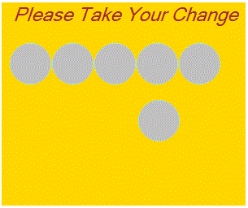
Code Behind the Default.aspx Page (6)
protected void RtnChanges(Int32 amount) { // Generate the Image of Coins
Int32 quarters = (Int32)(amount/25); // Calculate the number of coins
Bitmap imageCoin = new Bitmap(300, 250);
Graphics gCoin = Graphics.FromImage(imageCoin);
gCoin.FillRectangle(Brushes.Gold, 0, 0, 300, 250);
Font font = new Font("Alba Super", 18, FontStyle.Italic);
gCoin.DrawString("Please Take Your Change", font, Brushes.Brown, 10, 0);
SolidBrush silverBrush = new SolidBrush(Color.Silver);
int x = 10;
int y = 50;
int w = 50;
int h = 50;
for (int i = 1; i <= quarters; i++) {
Rectangle rec = new Rectangle(x, y, w, h);
gCoin.DrawEllipse(Pens.PowderBlue, rec);
gCoin.FillEllipse(silverBrush, rec);

Slide 16
Code Behind the Default.aspx Page (7)
if (i < 5) // put 5 coins in a raw
{
x = x + 52;
}
else
{ // put remaining coins in the next raw
y=120;
x = x - 50;
}
}
imageCoin.Save(Response.OutputStream, System.Drawing.Imaging.ImageFormat.Gif);
gCoin.Dispose(); // housekeeping
imageCoin.Dispose();
}
} // End of the code

Slide 17
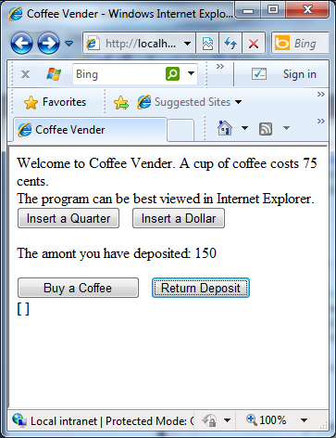
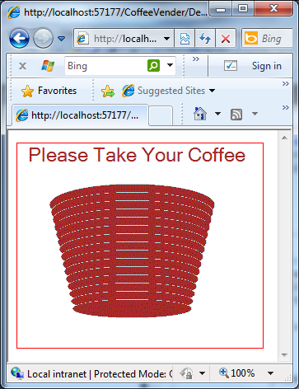
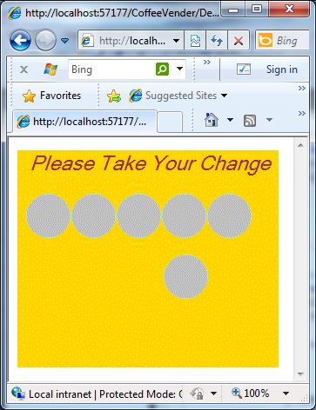
Demonstration
http://venus.eas.asu.edu/WSRepository/CoffeeVender/

Slide 18
Problems with the Simple Example
This simple example shows how dynamic graphics can be generated and displayed:
As a simple working example, the details are not fine-tuned.
The image overwrites the html page;
The rendered file is sent to the web forms, which seems to be browser-dependent:
The graphics works on IE;
The graphics does not work on Chrome and Firefox

Slide 19
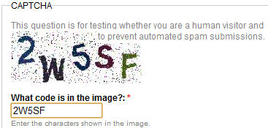
A Refined Implementation
http://venus.eas.asu.edu/WSRepository/CoffeeMachine/
The image is posted to the same web page without overwriting the forms;
Use “User Control” to implement the image generation
It works for IE, Chrome, and Firefox;
Take user-entered text (user name) and print the name on the coffee cup:
Potential application of implementing an image verifier to prevent programmed attacks

Slide 20
File Organization
Main GUI Page
Default.aspx
Default.aspx.cs
Register the user control
Image to be placed here
Image generated here
UserControlCup.ascx
UserControlCup.ascx.cs
User Control

Slide 21
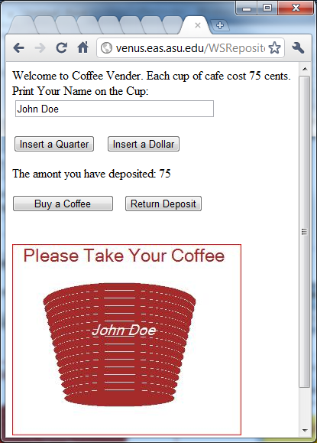
Demonstration and an Application
Demo for Image Verifier: http://venus.eas.asu.edu/WSRepository/FormsSecurity/
Generate a random string
Generate
image
2W5SF
=?
Image Verifier
Image Verifier

Slide 22
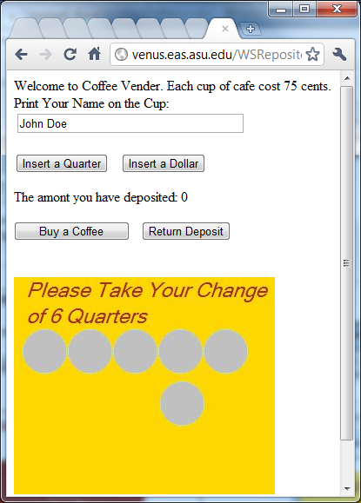
Demonstration
http://venus.eas.asu.edu/WSRepository/CoffeeMachine/
Calculating the change in the number of quarter

Slide 23
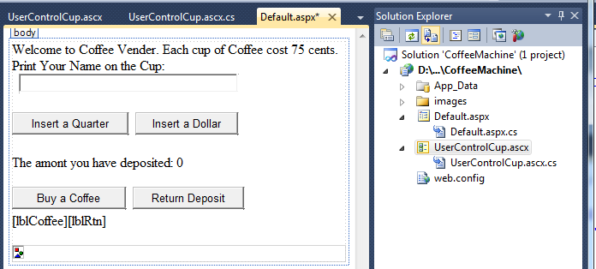
Default.aspx Design with User Control
Display image generated by the user control here

Slide 24
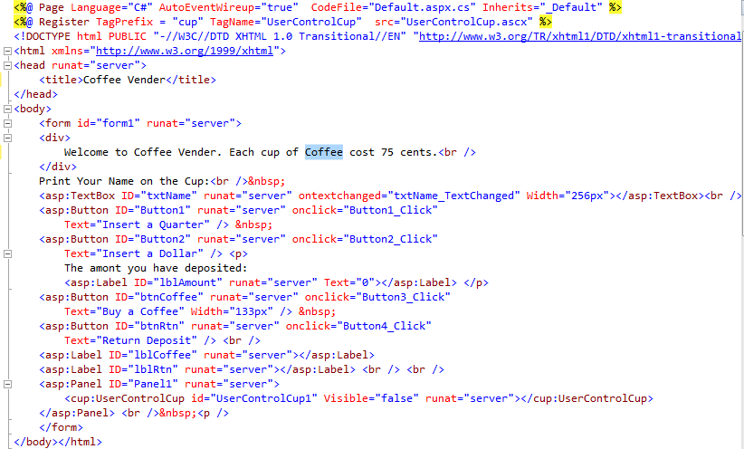
Default.aspx Source with User Control
Register the user control
Where to place the image
The image will not be displayed initially.

Slide 25
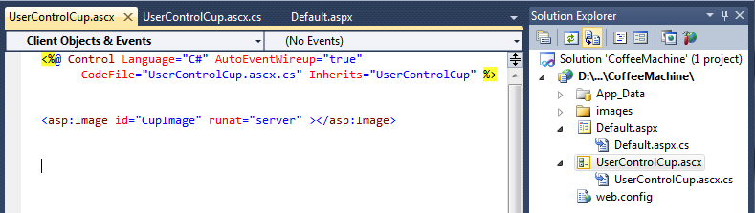
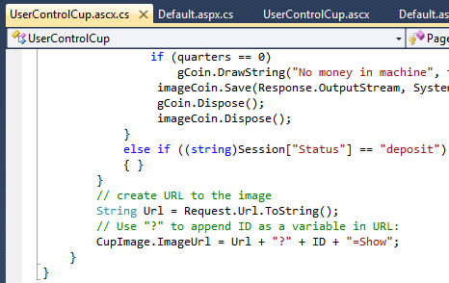
Source of the UserControlCup.ascx
Define the id = “CupImage” of the image generated by the user control. This id is used in the code behind the User Control to refer to the image.

Slide 26

Code Behind Default.aspx Page (1)
There is not much difference from the code in the previous example
using System;
public partial class _Default : System.Web.UI.Page {
protected void Page_Load(object sender, EventArgs e) {
if (Session["Sum"] == null)
Session["Sum"] = 0;
if (Session["Status"] == null)
Session["Status"] = "deposit";
lblAmount.Text = "0";
}
protected void Button1_Click(object sender, EventArgs e)
{ // insert quarter
Int32 Sum = (Int32)Session["Sum"];
Sum = Sum + 25;
Session["Sum"] = Sum;
lblAmount.Text = Convert.ToString(Sum);
UserControlCup1.Visible = false; // Hide the Image Display
Session["Status"] = "deposit";

Slide 27
Code Behind Default.aspx Page (2)
if (Sum < 75)
lblCoffee.Text = "Please deposit more money";
else
lblCoffee.Text = String.Empty;
}
protected void Button2_Click(object sender, EventArgs e)
{ // insert dollar
Int32 Sum = (Int32)Session["Sum"];
Sum = Sum + 100;
Session["Sum"] = Sum;
lblAmount.Text = Convert.ToString(Sum);
UserControlCup1.Visible = false; // Hide the Image Display
Session["Status"] = "deposit";
lblCoffee.Text = String.Empty;
}

Slide 28

Code Behind Default.aspx Page (3)
protected void Button3_Click(object sender, EventArgs e) { // buy Coffee
Int32 Sum = (Int32)Session["Sum"];
if (Sum >= 75) {
Sum = Sum - 75;
Session["Sum"] = Sum;
lblAmount.Text = Convert.ToString(Sum);
//lblCoffee.Text = "Please take your Coffee here";
Session["Status"] = "coffee";
UserControlCup1.Visible = true; // Display the Coffee Cup
}
else {
lblCoffee.Text = "Please deposit more money";
lblAmount.Text = Convert.ToString(Sum);
UserControlCup1.Visible = false; // No Display
}
}

Slide 29

Code Behind Default.aspx Page (4)
protected void Button4_Click(object sender, EventArgs e)
{ // return fund
Int32 quarters = (Int32)((Int32)Session["Sum"] / 25);
Session["Qarters"] = quarters;
Session["Sum"] = 0;
Session["Status"] = "refund";
UserControlCup1.Visible = true; // Display the returned coins
lblCoffee.Text = String.Empty;
}
protected void txtName_TextChanged(object sender, EventArgs e)
{
if (txtName != null)
Session["YourName"] = txtName.Text;
}
}

Slide 30
Code behind the User Control (1)
using System;
using System.Drawing;
public partial class UserControlCup : System.Web.UI.UserControl {
protected void Page_Load(object sender, EventArgs e) {
if (Request.Params[ID] != null) {
if ((string)Session["Status"] == "coffee") // Display Coffee Cup {
Bitmap imageCoffee = new Bitmap(300, 250);
Graphics gCoffee = Graphics.FromImage(imageCoffee);
gCoffee.FillRectangle(Brushes.White, 0, 0, 300, 250);
gCoffee.DrawRectangle(Pens.Red, 0, 0, 299, 249);
Font font = new Font("Alba Super", 18, FontStyle.Regular);
gCoffee.DrawString("Please Take Your Coffee", font, Brushes.Brown, 10, 0);
SolidBrush brownBrush = new SolidBrush(Color.Brown);
int x = 40;
int y = 50;
int w = 200;
int h = 50;

Slide 31
Code behind the User Control (2)
for (int i = 0; i < 15; i++) {
Rectangle rec = new Rectangle(x, y, w, h);
gCoffee.DrawEllipse(Pens.PowderBlue, rec);
gCoffee.FillEllipse(brownBrush, rec);
x = x + 2; y = y + 10;
w = w - 4; h = h - 2;
}
if (Session["YourName"] != null) {
font = new Font("Alba Super", 14, FontStyle.Italic);
String NameOnCup = (String)Session["YourName"];
gCoffee.DrawString(NameOnCup, font, Brushes.White, 100, 100);
}
imageCoffee.Save(Response.OutputStream, System.Drawing.Imaging.ImageFormat.Jpeg);
gCoffee.Dispose();
imageCoffee.Dispose();
}

Slide 32
Code behind the User Control (3)
else if ((string)Session["Status"] == "refund") { //Display coins
Int32 quarters = (Int32)Session["Qarters"];
Session["Status"] = "deposit";
Bitmap imageCoin = new Bitmap(300, 250);
Graphics gCoin = Graphics.FromImage(imageCoin);
gCoin.FillRectangle(Brushes.Gold, 0, 0, 300, 250);
Font font = new Font("Alba Super", 18, FontStyle.Italic);
if (quarters > 0) {
gCoin.DrawString("Please Take Your Change", font, Brushes.Brown, 10, 0);
String coins = "of " + quarters + " Quarters";
gCoin.DrawString(coins, font, Brushes.Brown, 10, 30);
SolidBrush silverBrush = new SolidBrush(Color.Silver);
int x = 10; // from left
int y = 60; // from top
int w = 50;
int h = 50;

Slide 33
Code behind the User Control (4)
for (int i = 1; i <= quarters; i++) { // Display coins one after another
Rectangle rec = new Rectangle(x, y, w, h);
gCoin.DrawEllipse(Pens.PowderBlue, rec);
gCoin.FillEllipse(silverBrush, rec);
if (i < 5) { x = x + 52; }
else {
y = 120;
x = x - 50;
}
}
}
if (quarters == 0)
gCoin.DrawString("No money in machine", font, Brushes.Brown, 10, 0);
imageCoin.Save(Response.OutputStream, System.Drawing.Imaging.ImageFormat.Jpeg);
gCoin.Dispose();
imageCoin.Dispose();
}

Slide 34
Code behind the User Control (5)
else if ((string)Session["Status"] == "deposit") // No Display
{ }
}
String Url = Request.Url.ToString();
if (Url.IndexOf("?") == -1)
{
CupImage.ImageUrl = Url + "?" + ID + "=Show";
}
else
{
CupImage.ImageUrl = Url + "&" + ID + "=Show";
}
}
}

Slide 35
Lecture Summary
The principles of using dynamic graphics
The model of generating dynamic graphics
Visual Studio GDI+ library
Simple Example of Generating Dynamic Graphics posting the image into the ASPX forms
Using User Control to generate images and confine the images in a part of the form.
Potential application in developing an image verifier, See text Section 7.3.4 for developing an image verifier.

